Slide 1
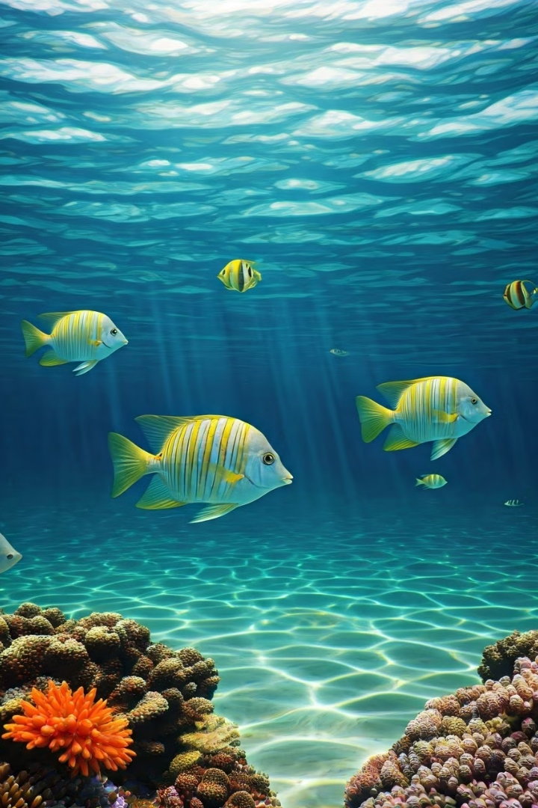

Fish Species Classification using Deep Learning
Advanced image recognition for underwater ecosystem management
Bridging computer vision and marine science
by Amal Prasad

Slide 2
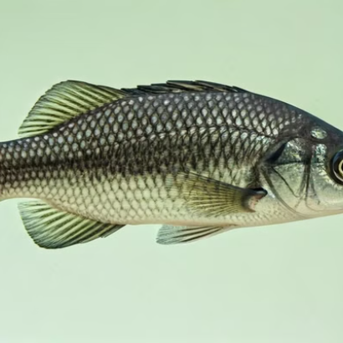
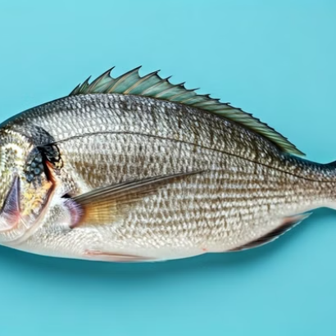
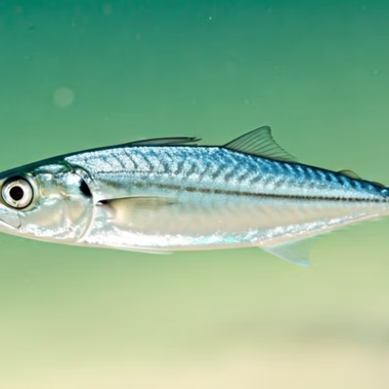
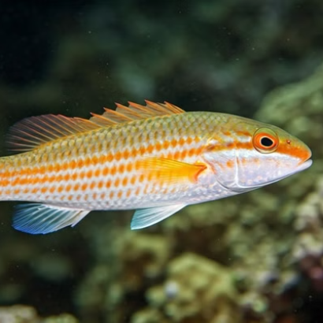
Dataset
Our model classifies 9 diverse fish species. The dataset includes Black Sea Sprat, Gilt Head Bream, Horse Mackerel, Red Mullet, Red Sea Bream, Sea Bass, Shrimp, Striped Red Mullet, and Trout.

Slide 3




Deep Learning Architecture
Multi-layer Feature Extraction
Captures hierarchical patterns from simple to complex features
Robust Pattern Recognition
Identifies distinct fish characteristics despite variable conditions
Adaptive Learning
Continuously improves through backpropagation and optimization

Slide 4
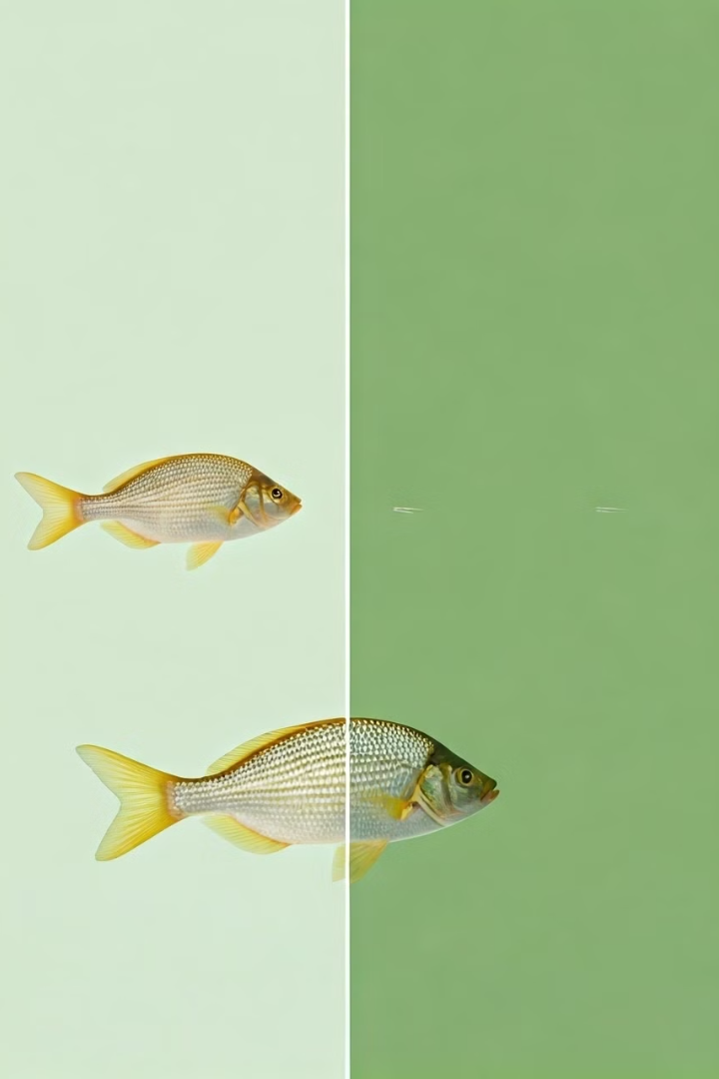
Model Training Process
Dataset Preparation
Training, testing and validation datasets carefully balanced for accuracy
Image Augmentation
Enhanced dataset diversity through rotation, color variation, brightness adjustments
Optimization
Fine-tuning parameters to maximize classification accuracy

Slide 5
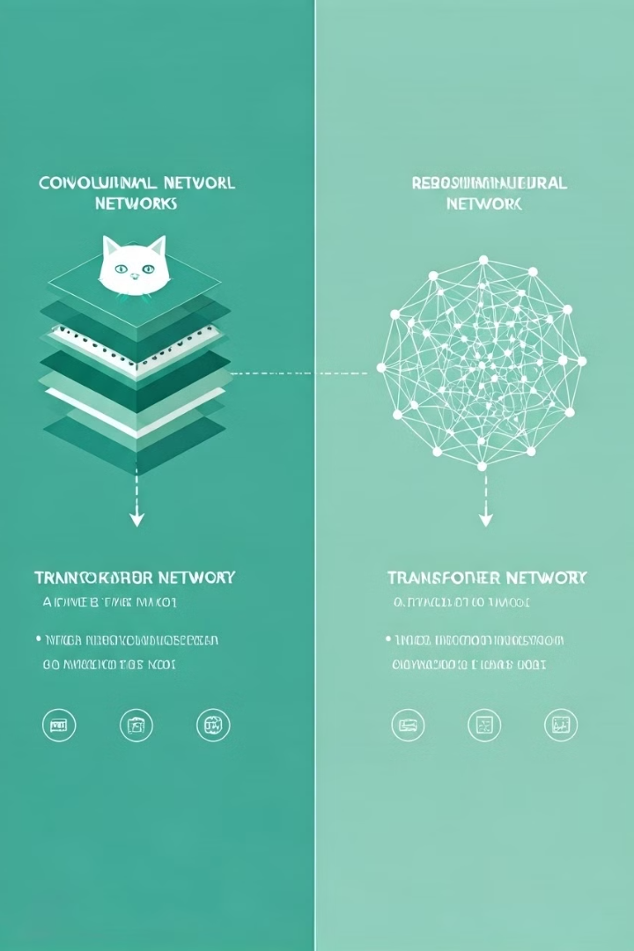





Pre-Trained Models Used
VGG16
ResNet152
ConvNext
Deep CNN with 16 layers known for simplicity and effectiveness
Extremely deep network with residual connections to prevent vanishing gradients
Modern architecture combining CNN strengths with transformer innovations
EfficientNetV2
ViT Visual Transformer
Optimized for both accuracy and computational efficiency
Applies transformer architecture directly to image patches for powerful global context learning

Slide 6
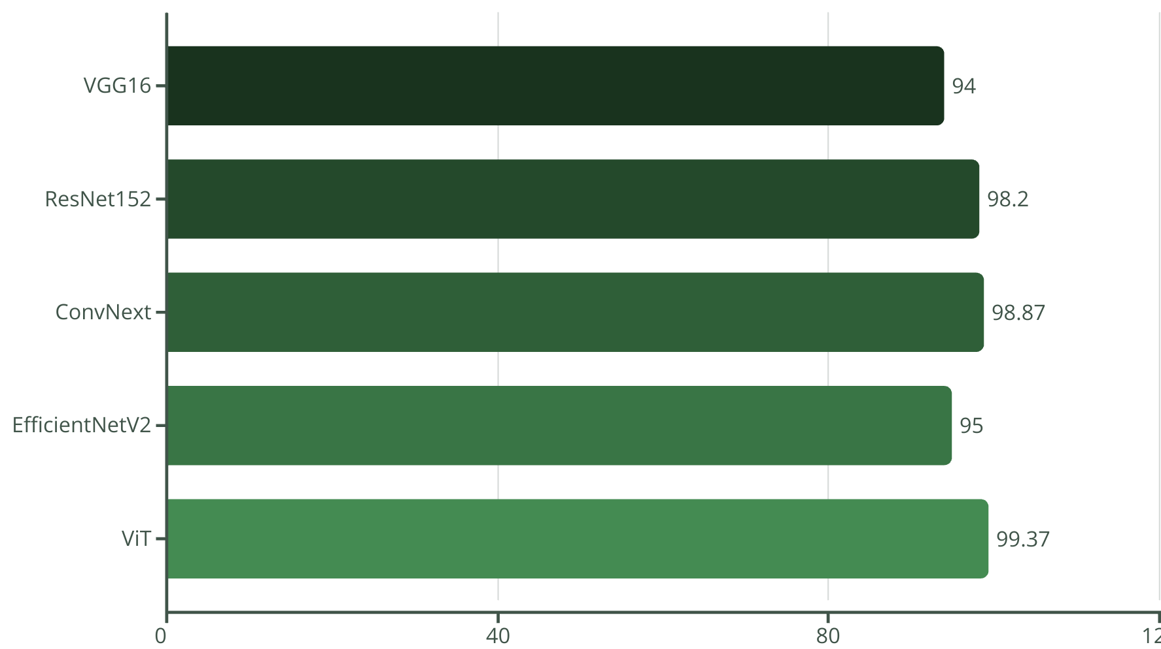
Comparative Analysis
ConvNext achieved highest accuracy at 95%. EfficientNetV2 offered best balance between performance and training time.

Slide 7
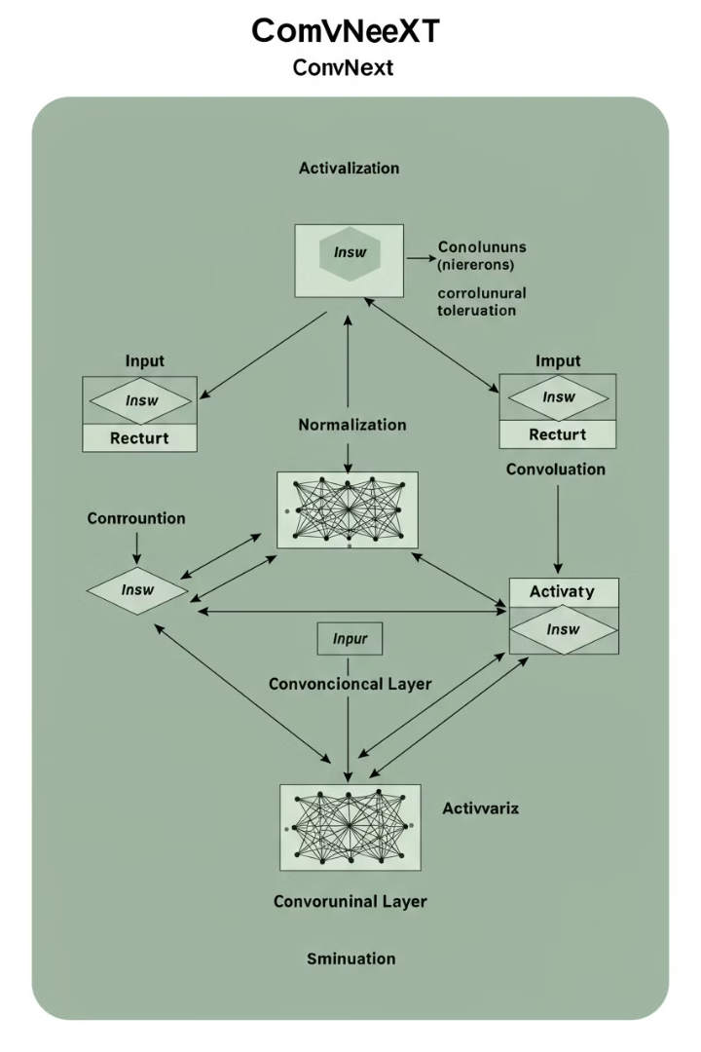
Model Used for Prediction
Hierarchical Design
Feature Extraction
ConvNext combines traditional convolutional layers with modern architectural innovations from transformer models.
Specialized in capturing fine details crucial for distinguishing similar fish species.
Computational Efficiency
Optimized structure enables fast inference while maintaining high accuracy.

Slide 8
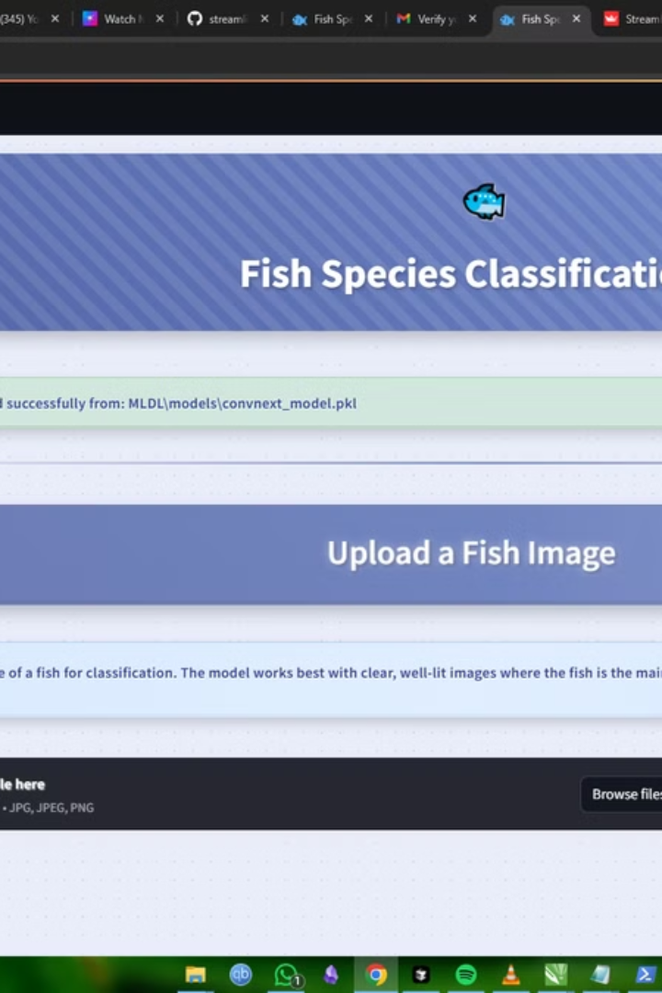




Streamlit Web Application
Image Classification
Identifies 9 different fish species from uploaded images
Cloud-Based Model
Uses ConvNeXt deep learning model hosted on Google Drive
Responsive Design
Works seamlessly on desktop and mobile devices
Accessibility Features
Visual feedback and optional sound effects

Slide 9







Technology Stack
Model Deployment
Serving the trained model to users
GitHub
Version control and collaboration
Cloud
Scalable infrastructure for hosting
Transfer Learning
Leveraging pre-trained models
Streamlit
Web application framework
PyTorch
Deep learning framework
7
Python
Core programming language

Slide 10






Conclusion
Web Application
Developed interactive Streamlit interface with cloud-based model
Accurate Classification
Successfully built CNN-based fish classifier with 99% accuracy
Learning Outcomes
Gained expertise in creating interactive AI applications

Slide 11

Thank You!
Created By- Amal Prasad

